Slide 1

WELCOME

Slide 2
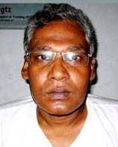
Introducing myself
Nikhil Chandra Biswas
Asst. Teacher
Iswardi High School
Khoksa, Kushtia

Slide 3
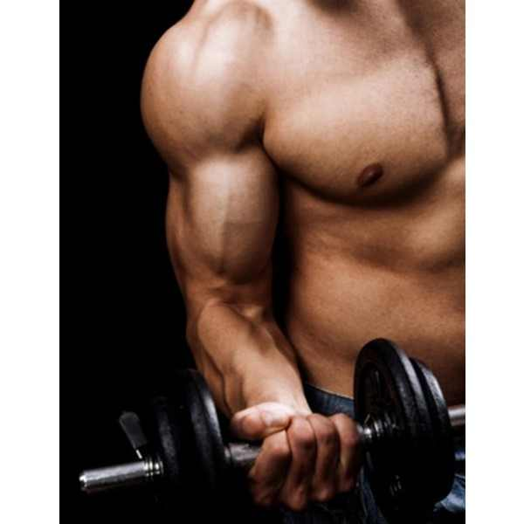

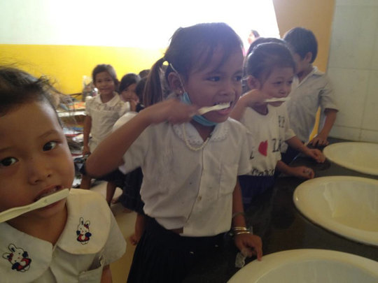
1.Body Building 2.Washing 3.Brushing
Class: Eight
Sub : English 1st paper
Unit : 3 (three)
Title : HEALTH & HYGIENE

Slide 4
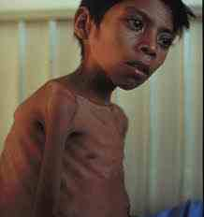
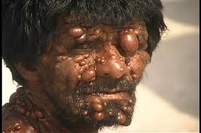
1.An unhealthy boy 2. A healthy man 3. A diseased person
All the pictures you can see above are connected with HEALTH either good or bad.
So, our today’s lesson is HEALTH.
Unit : Three
Lesson : One
Title : Health

Slide 5
Objectives :
After we have studied this lesson, we will be able to
Read and understand text through silent reading
Understand what health actually means
Differentiate between good health & bad health
Make questions
Write the answers to questions

Slide 6
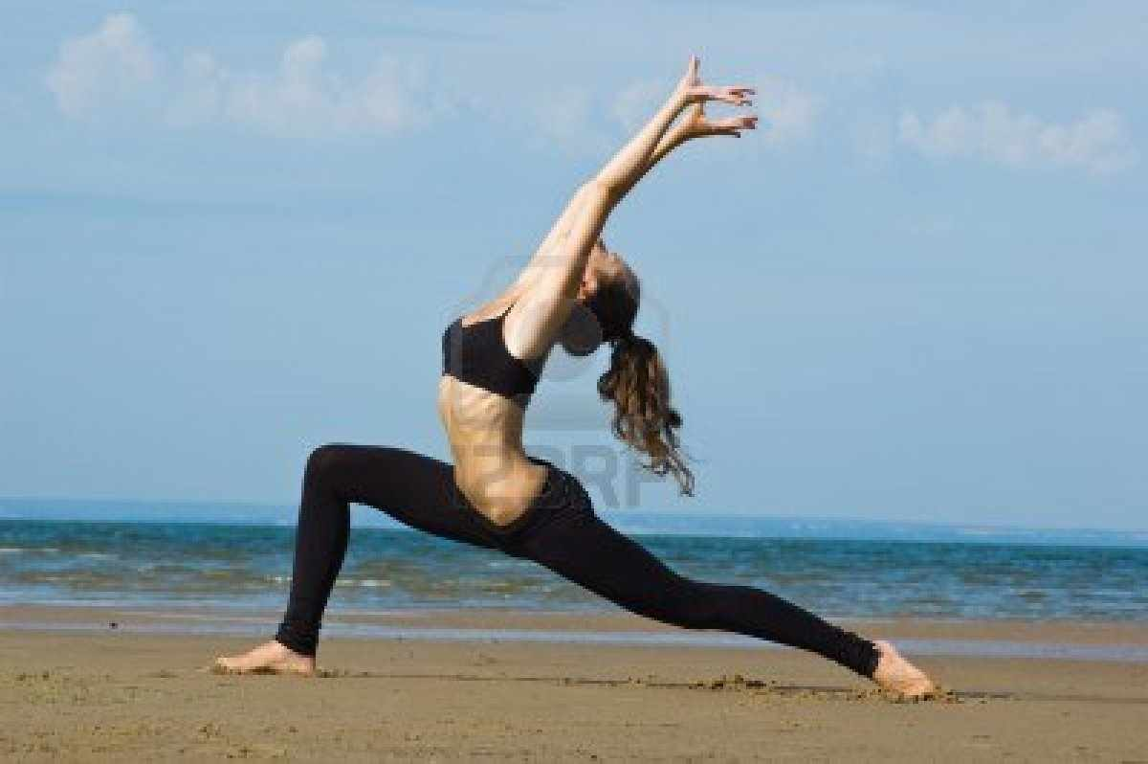

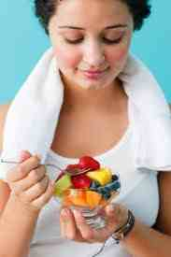
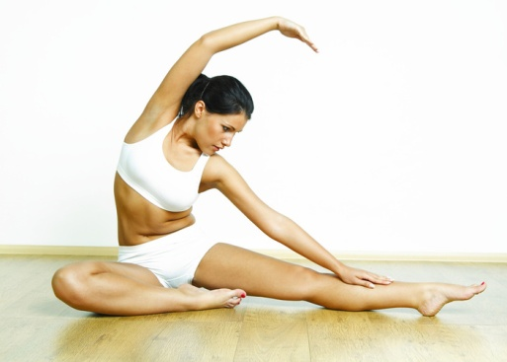
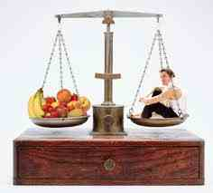
Let’s see some pictures and try to guess what is happening there

Slide 7
As you have seen the pictures and heard my lecture , now you can easily guess the theme of the text.
Now read the text and try to locate the new words

Slide 8
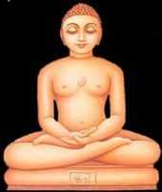

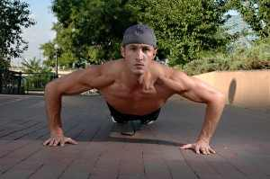
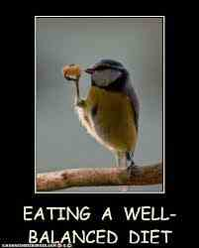
A diseased person
Disease= ill/sick/unfit
Concentrate
Meditation
Concentrate= to be more and more attentive
A house with a car
Possession=wealth
These two things are essential for good health . Essential = necessary

Slide 9


There is a proverb: Early to bed and early to rise makes a person healthy, wealthy and wise.
Setting sun
Rising Sun

Slide 10
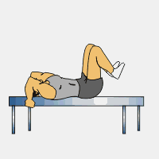

Group Work: Make a list of what we are to do for keeping good health

Slide 11
Make three questions individually
1. Who is a healthy man ?
A sound mind in sound body

Slide 12
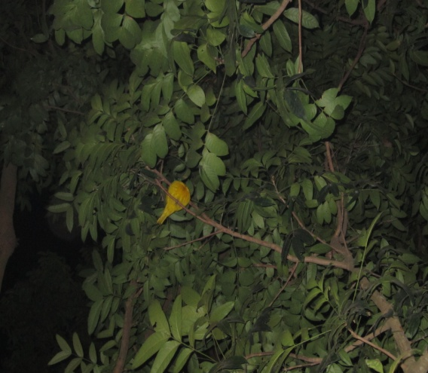
2. What do we need to eat ?
3. What does the phrase ‘to keep late hours’ mean ?

Slide 13
Home Work : Write a short paragraph on how you can maintain good health

Slide 14

That’s all about my lesson and I like to come to an end by giving you thanks with a red rose.

